Slide 1
Auto marking Program
Mir-Lab, Hanyang University
Version | Date | Writer | Modification | Note
1.0 | 2018-01-08 | HYUNJIN PARK | Web Server & Client Draft | -

Slide 2
Contents
Conception
Auto marking Purpose
Auto marking Process
List of Programs
System Instruction
System Architecture
5. System Overview (How to approach)
Grading Items
6. Project Introduce and Grading Items
Web Server
Web Client
UDP Chatting

Slide 3
1. Auto Marking Purpose
Auto Marking Definition(Online Judge)
As the artificial intelligence society develops, the development of automatic scoring program for program codes is spreading in various countries and various companies. The goal of the program is to analyze and evaluate the input program in terms of various test case and process, to recognize the error in the process through Code Review, and to improve the ability to solve problems and performance.

Slide 4
1. Auto Marking Purpose
Auto Marking Definition
The automatic scoring and analysis system focuses on analyzing and evaluating network programs in addition to data structures and algorithms. This program evaluates programs (server) such as TCP, UDP Socket Chatting, ARP (Stop and Wait, Go Back N), Checksum and application level Raw Socket, and give feedback problems and performance to the user.
Online Judge Program(Algorithm) : Hacker Rank, Code Ground, Codility, Baekjoon and etc.

Slide 5
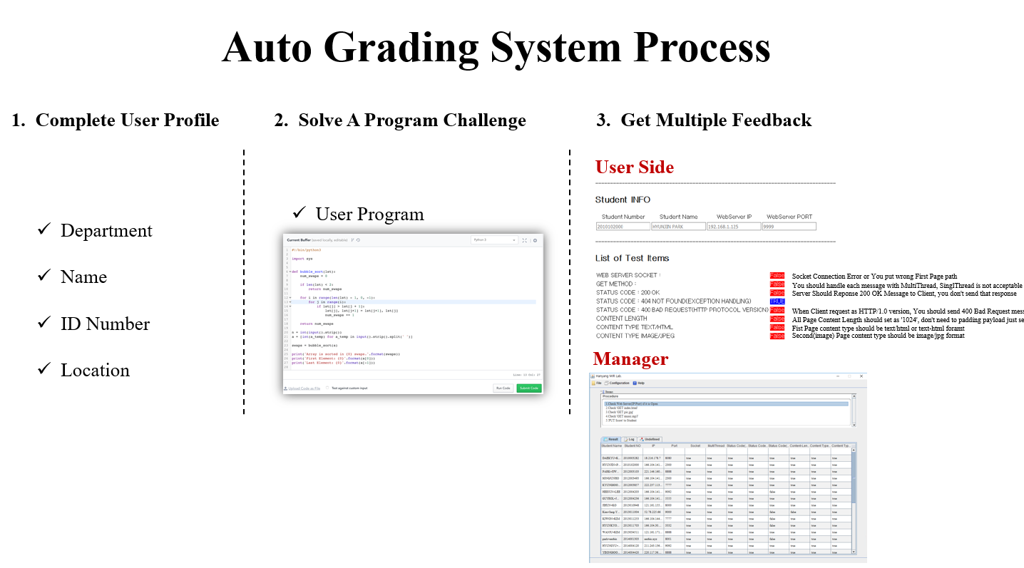
2. Auto Grading System Process

Slide 6
3. List of Programs
Sort | Contents
Network Programming 2018 | Web Server(Web Restful API) Grading Items: Restful, Response Code(Error, Correct), Protocol Version, Header, Multithread
 | Web Client(Web Restful API) Grading Items: Restful, Receive Buffer, Picture, Text, Protocol Version, Header
 | UDP Chatting P2P Grading Items: UDP Server(Send, Receive, Multithread), UDP Client(Send, Receive), P2P Structure(Server, Client)
Network Protocol 2019 | Go Back N Grading Items: Socket, Multi Thread, Message Format, Data Integrity, Protocol(Message Flow)
 | Selective Repeat Grading Items: Socket, Multi Thread, Message Format, Data Integrity, Protocol(Message Flow)
 | LLDP Grading Items: TLV, Data Integrity (Future Work, ongoing Project)
 | ICMP Grading Items: Ping Test (Future Work, ongoing Project)
Protocol Benchmarking | Openflow Server Grading Items: Message Flow of Openflow Protocol(Sequence, Data Integrity), LLDP(Future Work, ongoing Project)
 | Openflow Agent Grading Items: Message Flow of Openflow Protocol(Sequence, Data Integrity), LLDP(Future Work, ongoing Project)
 | MQTT Grading Items: Publish, Subscribe, EMAP, OpenADR2.0b(Future Work, ongoing Project)
 | CoAP Client & Server Grading Items: Restful API, Multithread, Observe, EMAP, OpenADR2.0b(Future Work, ongoing Project)

Slide 7
4. System overall architecture
Auto Grading System
Client
(Student)
HTTP 1.1 / GET : index Page
HTTP 1.1 / 200 OK: index.html
Back-end Server(JAVA)
Select Grading Program
*Create Socket or Thread
Share Connection Information
Program
(e.g. HTTP Server)
Test Start
* Store Test Result on Server
Database(MySQL)
127.0.0.1
*Give Test Result and Comment

Slide 8
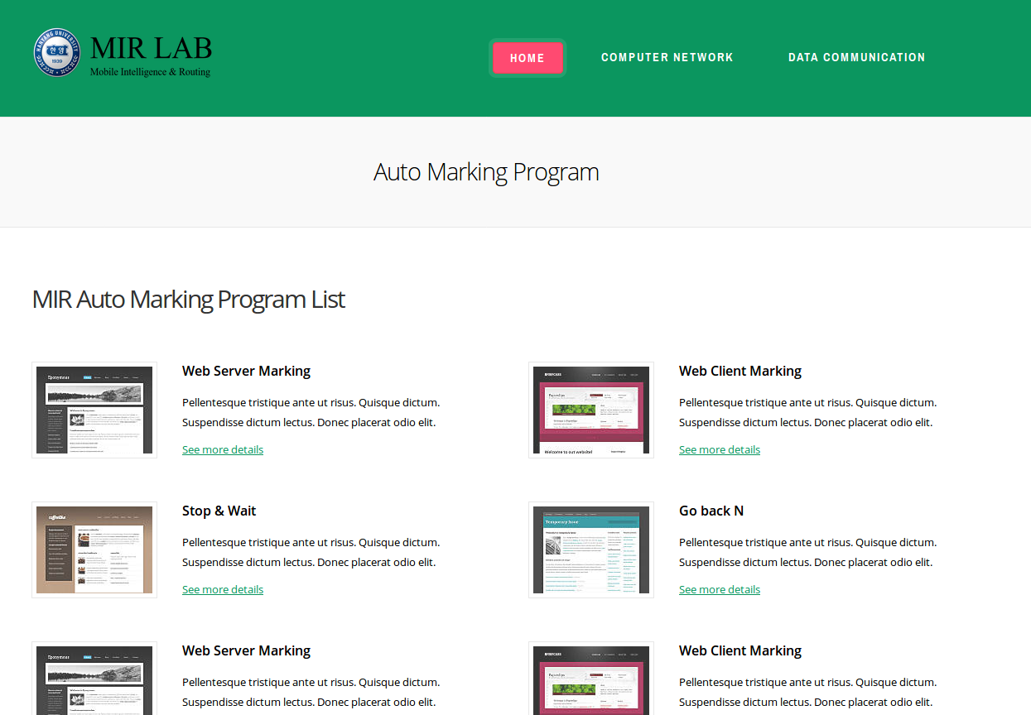
5. System Overview – Index
Choose Subject on Index Page and then you select the Marking Program
on the list

Slide 9
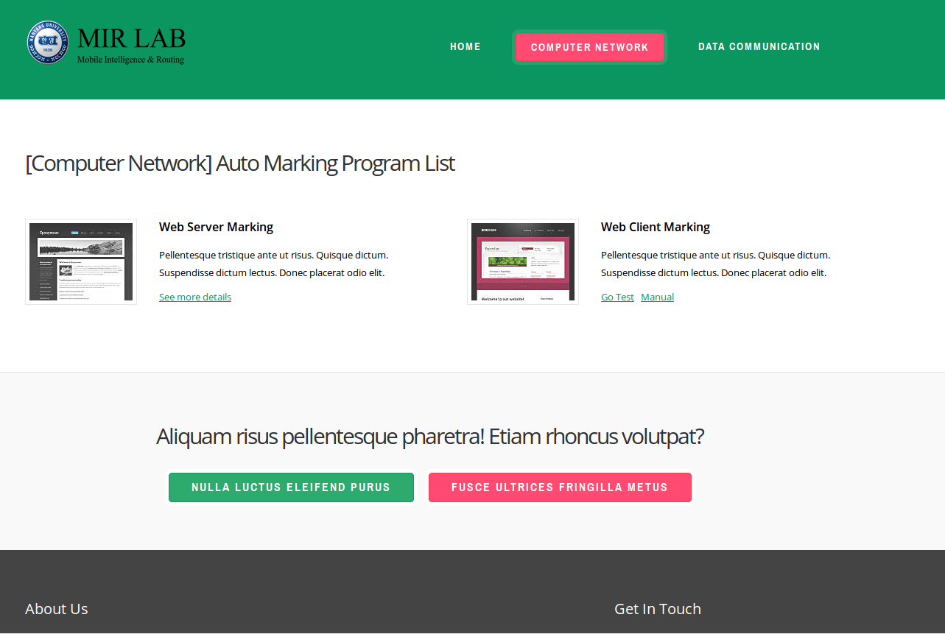
5. System Overview – Marking List
(1) Go Test
: Go to Test main page
(2) Manual
: User Manual

Slide 10
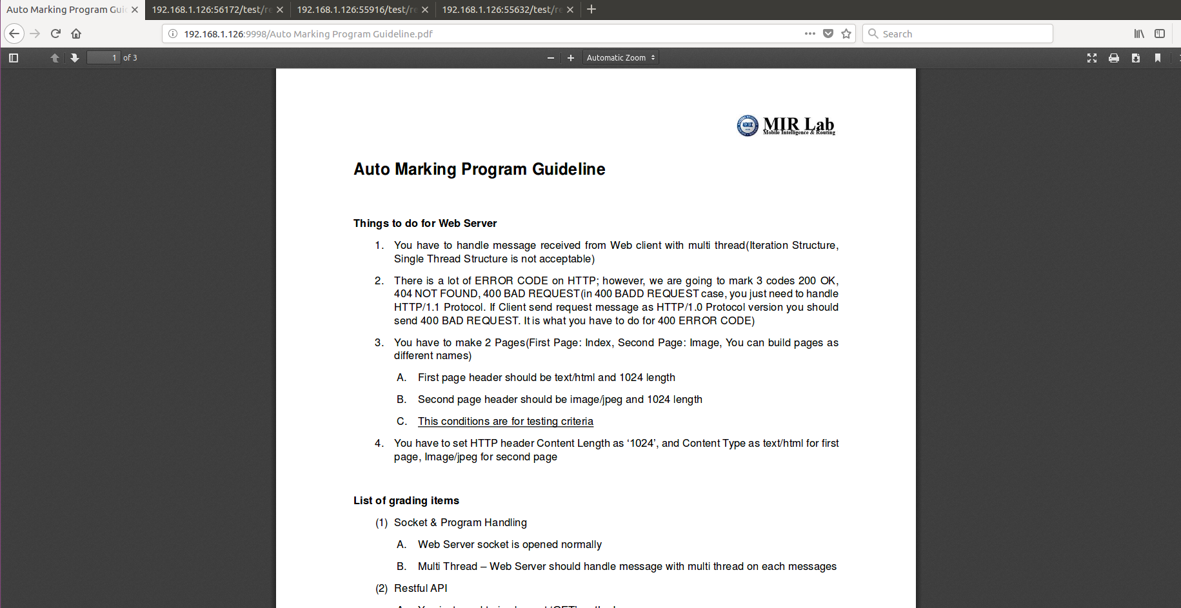
5. System Overview – User Manual
User manual : Things to do, List of grading items, How to mark

Slide 11
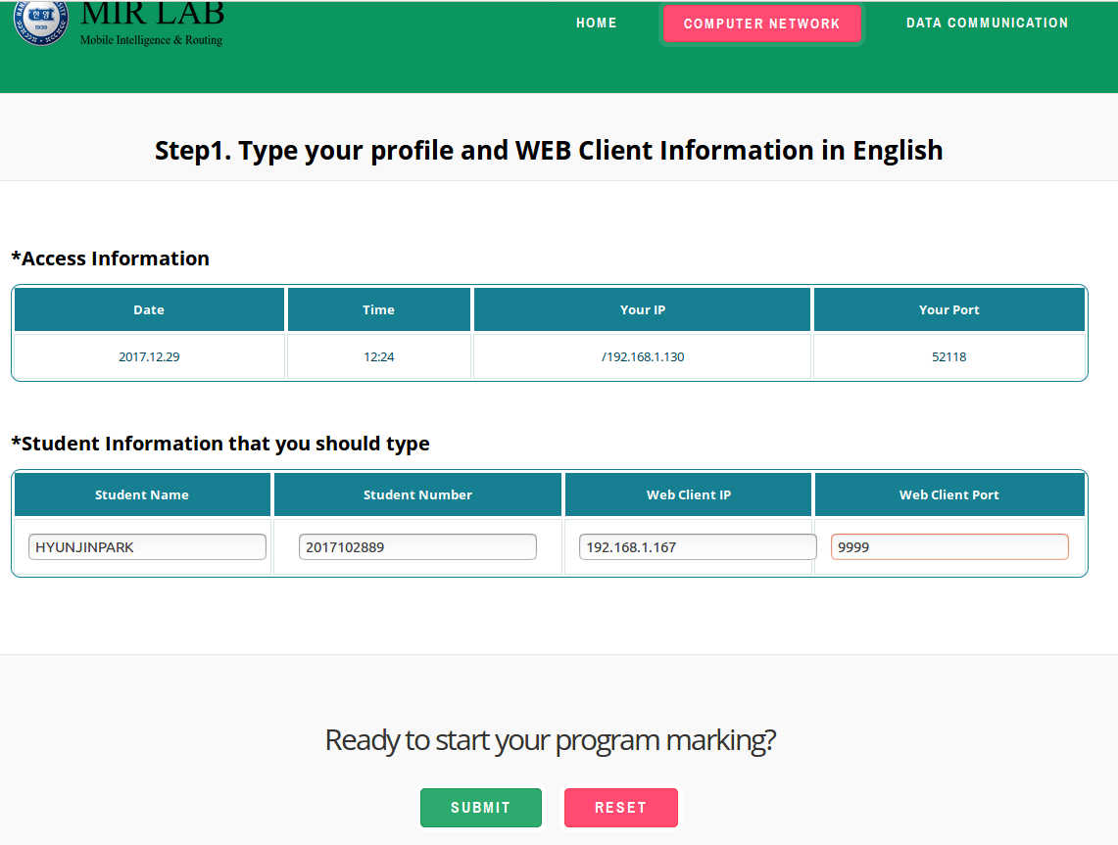
5. System Overview – User Information
User Information
`
(1) User should fill out all the information, e.g. Student name, Student Number, IP, Port.
(2) After click the submit button then you can start to mark your program.

Slide 12
6. Project 1: Web Server
I. Make your Web Server and Report
Connect webserver with your Internet Browser
Capture your webserver and browser
Make a Report with your code explanation, program pictures and Feelings
II. Mark with an automatic scoring program (Reference Auto Marking Program Guideline_WEB Server)
Mission 1: WEB SERVER SOCKET
Mission 2: GET METHOD
Mission 3: STATUS CODE : 200OK
Mission 4: STATUS CODE : 404 NOT FOUND(EXCEPTION HANDLING)
Mission 5: STATUS CODE : 400 BAD REQUEST(HTTP PROTOCOL VERSION )
Mission 6: CONTENT LENGTH
Mission 7: CONTENT TYPE TEXT/HTML
Mission 8: CONTENT TYPE IMAGE/JPEG

Slide 13
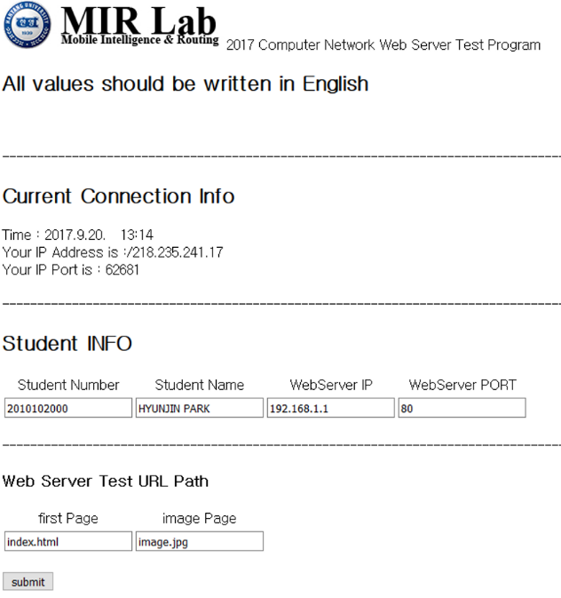
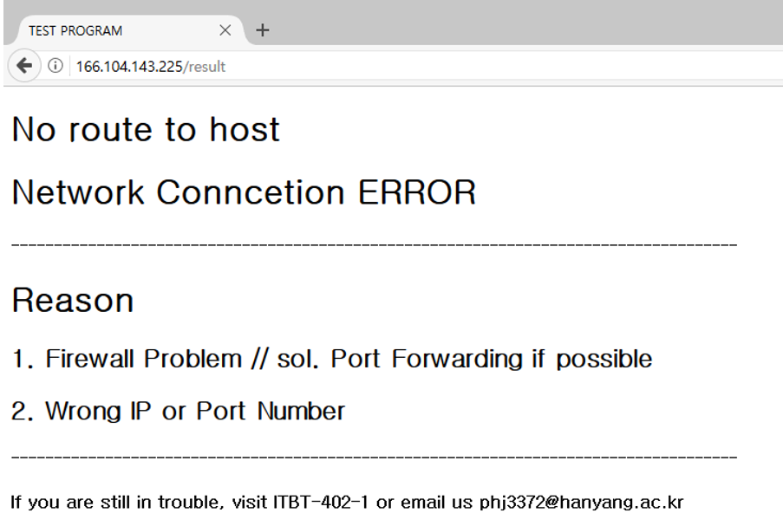
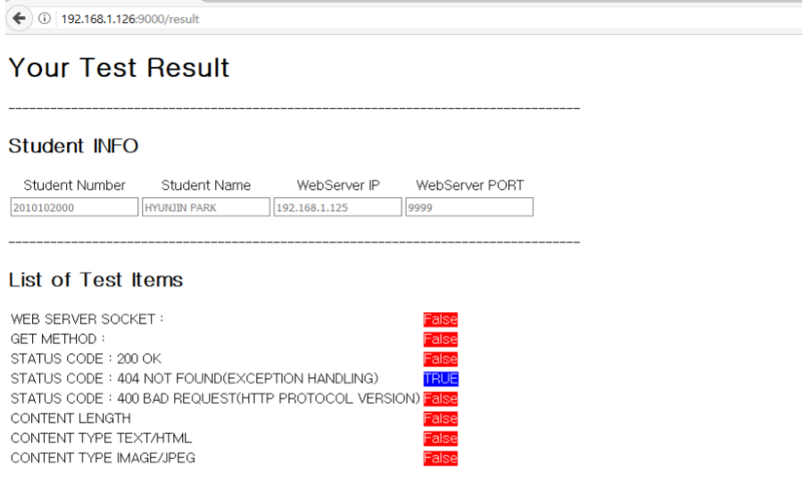
6. Project 1: Web Server
List of grading items
Mission 1: WEB SERVER SOCKET
Mission 2: GET METHOD
Mission 3: STATUS CODE : 200OK
Mission 4: STATUS CODE : 404 NOT FOUND(EXCEPTION HANDLING)
Mission 5: STATUS CODE : 400 BAD REQUEST(HTTP PROTOCOL VERSION )
Mission 6: CONTENT LENGTH
Mission 7: CONTENT TYPE TEXT/HTML
CONTENT TYPE IMAGE/JPEG

Slide 14
6. Project 2: Web Client
I. Make your Web Client and Report
Connect Webserver with your Webserver
Capture your Webserver and WebClient
Make a Report with your code explanation, program pictures and Feelings.
II. Mark with an automatic scoring program (Reference Auto Marking Program Guideline_WEB Client)
Mission1 : Handle USER-AGENT in HTTP Request header
Mission2 : GET/POST Method Request
Mission3: POST Method
(Optional) Mission4: GUI

Slide 15
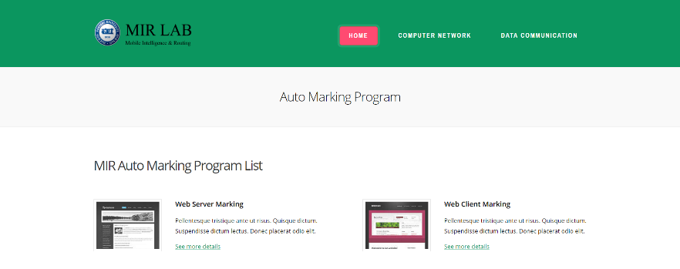
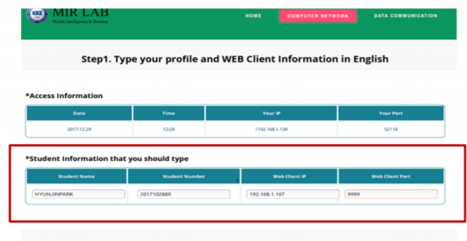
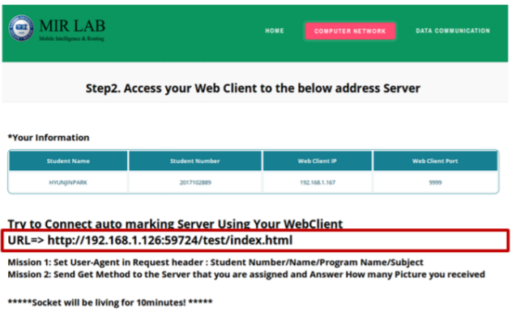
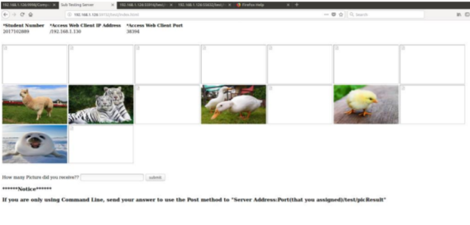
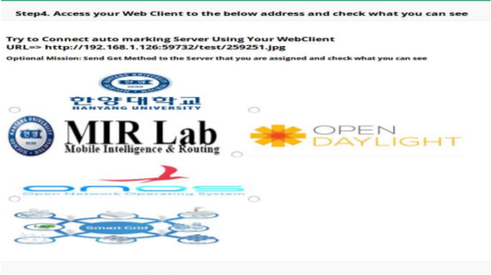
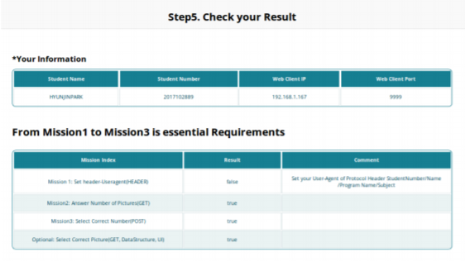
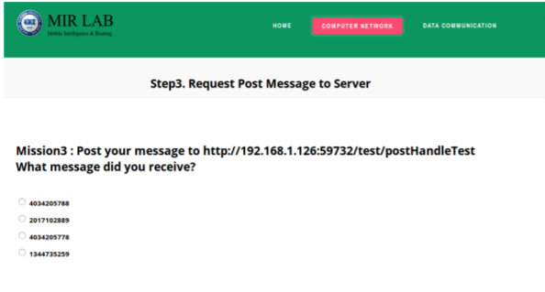
6. Project 2: Web Server
List of grading items
Mission1 : Handle USER-AGENT in
HTTP Request header
Mission2 : GET/POST Method Request
Mission3: POST Method
(Optional) Mission4: GUI Image

Slide 16
6. Project 3: UDP P2P Chatting
I. Make your UDP P2P Chatting Program and Report
Make a UDP Server and UDP Client
Connect UDP Server and UDP Client
Capture, Communicating your UDP Server and UDP Client Program
Optional : Combine Chatting program & GUI Program (extra)
Make a Report with your code explanation, program pictures and Feelings
II. Mark with an automatic scoring program (Reference Auto Marking Program Guideline_UDP Chatting)
Mission 1: Socket & Program Handling and Send Hello
Mission 2: Check User Information Student Name/Student Number (e.g. HYUNJINPARK/2017102889)
Mission 3: Multi Thread - Server should handle message with multi thread on each message
Mission 4: P2P Structure - Should Send Message by using your UDP Client in order to resolve this your program should be P2P Structure
Mission 5: P2P Structure based Calculator - Based on P2P Structure, Resolve that formula by using Calculator function(Should add)

Slide 17
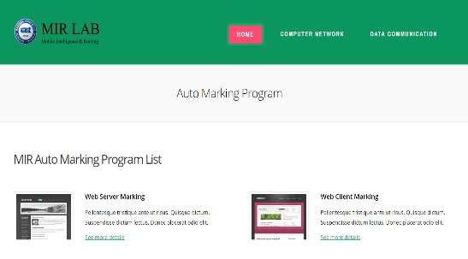
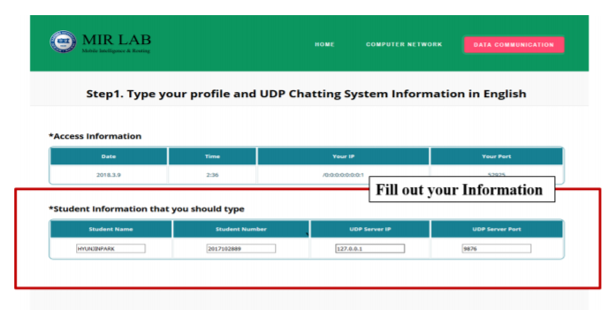
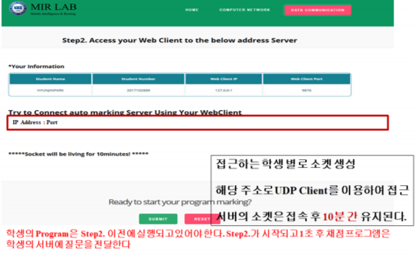
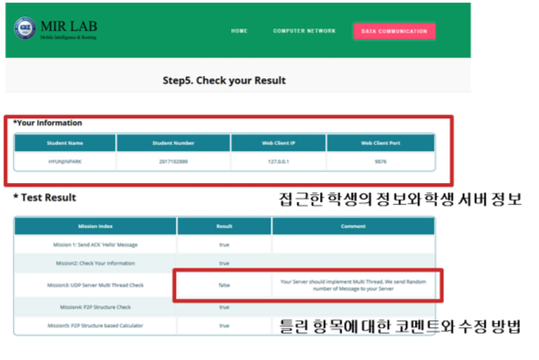
6. Project 3: UDP P2P Chatting
List of grading items
Mission 1: Socket & Program Handling and Send Hello
Mission 2: Check User Information Student Name/Student Number (e.g. HYUNJINPARK/2017102889)
Mission 3: Multi Thread - Server should handle message with multi thread on each message
Mission 4: P2P Structure - Should Send Message by using your UDP Client in order to resolve this your program should be P2P Structure
Mission5: P2P Structure based Calculator - Based on P2P Structure, Resolve that formula by using Calculator function(Should add)

